Slide 1
Conservation of Mass and the Advection Dispersion Equation

Slide 2
What you should know by the end of this Chapter:
Basic Control Volume Analysis
Derivation of the Advection Dispersion Equation
Fundamental Solution
Spatial Moments
Breakthrough Curves and Temporal Moments
Step and Step Up-Down Conditions
Linear Superposition

Slide 3
Control Volume
Recall the idea of a Control Volume - Consider an arbitrary volume of your choosing and write an equation for conservation of mass for it
This is the most fundamental and important law for anything relating to transport of contaminants
Change in Mass
=
Amount of Mass Flowing in – Amount of Mass Flowing out
Rate of change of Mass
in Control Volume
Mass flow rate in
(sum of all in)
Mass flow rate out
(sum of all in)

Slide 4
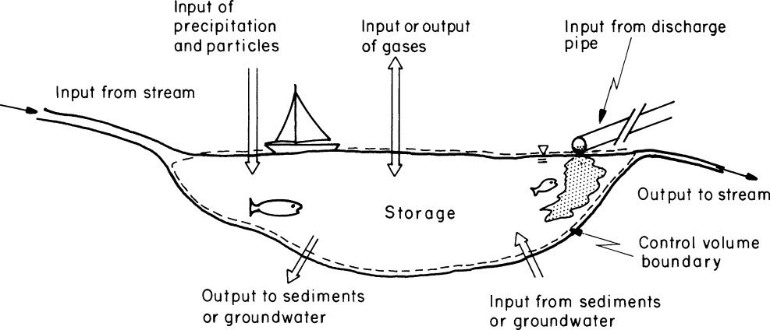
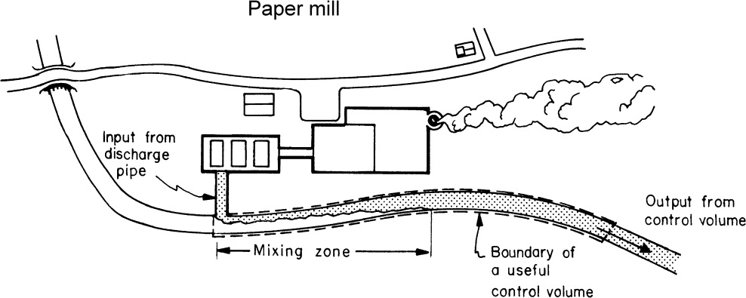
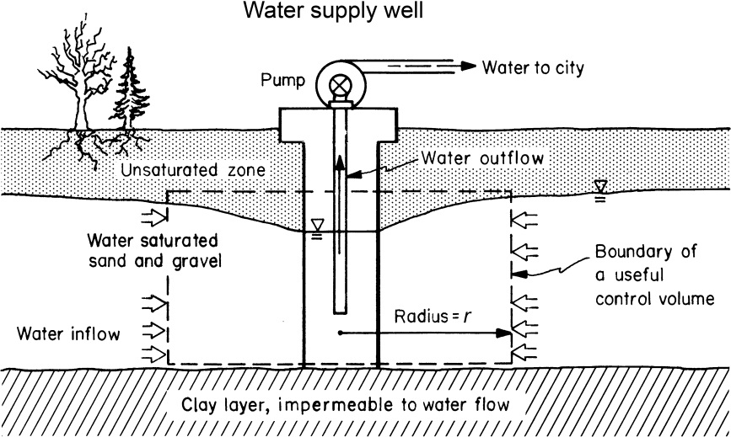
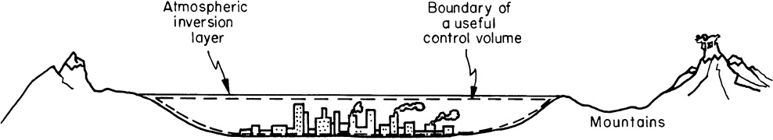
Control Volumes can be Anything YOU choose them to be

Slide 5
Example
A reservoir is filled with a volume of water of 1000m³. There are two streams that flow into the reservoir. Stream 1 flows in at a flow rate of 10m³/min and Stream 2 at a flow rate of 20m³/min. There is a single outlet. You know that the volume of the reservoir does not change over time and leakage and evaporation losses are negligible. Stream 1 is highly contaminated with Chromium at a concentration of 1 gram/liter. Stream 2 is pristine. Assuming that mixing in the reservoir is very vigorous such that the concentration in it is always completely uniform, write an equation for the evolution of concentration in the reservoir. If a time equal zero the water in the reservoir is pristine, how long will it take for the concentration in it to reach half of contaminated stream’s concentration. In the long run what will the final concentration in the reservoir be?

Slide 6
What if we consider an infinitessimal control volume?
Start in 1d (as in nothing can flow in y and z)
Δz
Δy
Δx
(Mass flux)

Slide 7
What if we consider an infinitessimal control volume?
Start in 1d (as in nothing can flow in y and z)
Δz
Δy
Δx
What is the flux j?

Slide 8
What is the flux j?
Well – how can mass move across your control plane?
Think of Three Different Mechanisms that can cause mass to move across the control plane
  Advection
  Diffusion
  Dispersion

Slide 9
Basics on Contaminant Transport
What processes do we usually consider?
Advection – the solute simply moves with the velocity of the surrounding fluid

Slide 10
Basics on Contaminant Transport
What processes do we usually consider?
Diffusion – Because molecules bounce around randomly and off one another they also spread randomly (usually a slow process)
Cause solute to dilute, because it spreads over a greater area/volume

Slide 11
Quiz
A room is 10 meters long. The coefficient of molecular diffusion is 10⁻⁹ m²/s. If something is released in the room how long does it take diffusion to spread it throughout the whole space.
What if it is 0.1, 1 or 100 meters long?

Slide 12
Basics on Contaminant Transport
Turbulent Dispersion
Dispersion – Because of random fluctuations in the flow (because of turbulence or boundaries) solute molecules spread over a greater area/volume (usually much faster than diffusion)
Causes solute to dilute, because it spreads over a greater area/volume

Slide 13
Basics on Contaminant Transport
Mechanical Dispersion
Dispersion – Because of nonuniformity in the background flow solute molecules spread over a greater area/volume (usually faster than diffusion)
Causes solute to dilute, because it spreads over a greater area/volume

Slide 14
Recall
Start in 1d (as in nothing can flow in y and z)
Δz
Δy
Δx
What is the flux j?

Slide 15
The Advection Dispersion Equation
This is the most fundamental transport equation you will likely encounter and is important for transport in all environmental systems.
The details on where u and D_{tot} come from will vary from system to system, but the overall equation will be the same.

Slide 16
In General
ADE in general Dimensions
If flow is incompressible
In 3d (for constant D and incompressible flow)

Slide 17
1d ->The Fundamental Solution
Mass of solute injected
Solution

Slide 18
3 important properties
Peak Concentration
Center of the Plume
Characteristic Width of the Plume

Slide 19
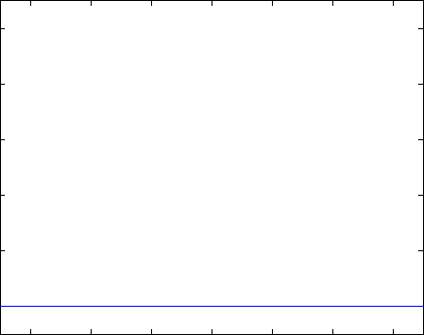
What the fundamental solution looks like
Concentration
Distance

Slide 20
Sample Problem
Water in a pipe is flowing at 0.5 m/s. You inject a pulse of 100g into the pipe at a given location. Molecular diffusion is 10⁻⁹m²/s. Flow is laminar. Mechanical dispersion is 2x10⁻²m²/s.
What will the maximum concentration be 100 meters down from the injection point?
How far downstream must one go so that the maximum concentration at any given point will be 10 times less than this value?

Slide 21
Spatial Moments
Moment
Zeroth Moment
First Moment
Second Moment
Second Centered Moment (κ₁₁=m₂-m₁²)

Slide 22
Spatial Moments
Zeroth Moment – 1 (normalized total mass)
First Moment – vt (center of mass)
Second Moment – 2Dt+v²t² (measure of weight of plume relative to a reference point)
Second Centered Moment - 2Dt (a measure of the width of the plume that increases due to dispersion)

Slide 23
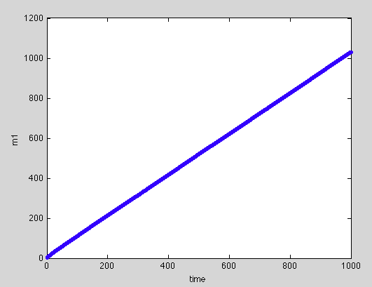
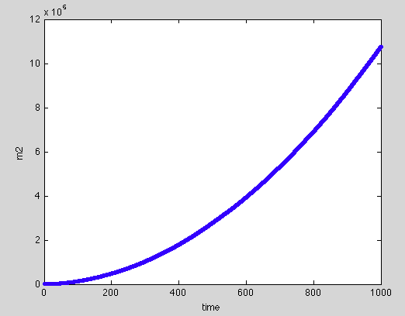
Sample Question
A geophysicist has provided you with the following plots of the first and second moment of a plume. Can you infer the advection speed and the dispersion coefficient?

Slide 24
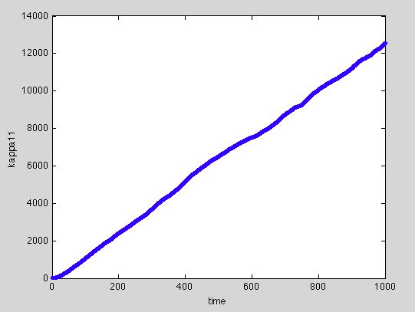
Show random walk model??

Slide 25
Breakthrough Curves
Measuring the distribution of concentration over space is pretty hard. You need to have a lot of sensors or measuring points spread out over lots of points. However measuring the concentration at one point and how it varies over time is much easier.
The resulting curve of concentration against time is called a Breakthrough Curve (BTC for short).

Slide 26
Temporal Moments of Breakthrough Curves
Another popular method is to look at temporal moments of breakthrough curves (i.e. you have a concentration measurement at a fixed distance x and integrate over time)
It is often easier to measure breakthrough curves than spatial distribution of solutes and this information can also be used to infer parameters (such as v and D in the ADE).

Slide 27
Evaluating these for ADE
For

Slide 28
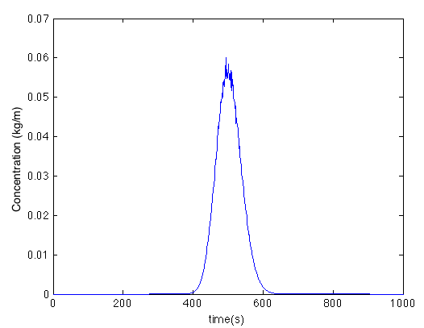
Example Problem
The following breakthrough curve is measured in a stream 100 meters downstream of a location where you injected a pulse of a conservative solute. The mass you threw in is 1 kg. The data associated with this curve in available for download. From this breakthrough curve can you infer what the velocity of the water in the stream is and what the total dispersion coefficient for the solute is?
See Matlab code tmoment_sample_problem.m

Slide 29
Linear Superposition
Imagine you have two spills
Concentration in your domain is always

Slide 30
Sample Problem
A spill of a contaminant has occurred at two locations along a pipe. One is 10 m downstream from the other. Each spill was short and over a small area. The upstream spill is 6 kg and the downstream spill is 4 kg.
The flow velocity is 2 m/s and the total dispersion coefficient is 0.5 m²/s.
What is the concentration that will arrive at a location 100 m downstream from the spills?

Slide 31
Different Condition 1:Step Condition
Heaviside Step Function
H(y) =1 if y>0
=0 if y<0
Concentration behind x=x₀
Is C₀ and ahead of it zero

Slide 32
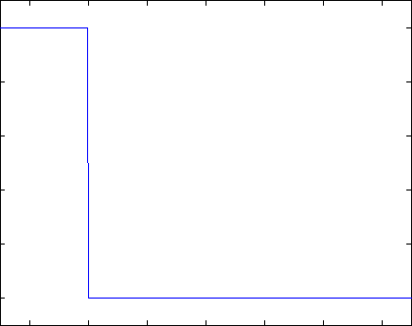
Example Movie

Slide 33
Different Condition 2: Wide Pulse Condition
Heaviside Step Function
Concentration between
x₁<x<x₀ is C₀
Elsewhere is 0

Slide 34
In principle you can build whatever complex solution you now want to.. E.g.
There is a spill made up of three sections. Between x=5 and 10 the spill is of concentration 3 kg/m. Between x=-10 and -5 it has concentration 5 kg/m. Between x= -3 and 3 it has concentration 4 kg/m.
Velocity is v and total dispersion D.
Write down a solution for how the concentration in this system evolves in space and time.
Plot solution for D=10⁻²ms⁻², v=1ms⁻¹ and t=1s
See Matlab Code Linear_Sup_Steps.m

