Slide 1
Chapter 8 - The Atmosphere

Slide 2
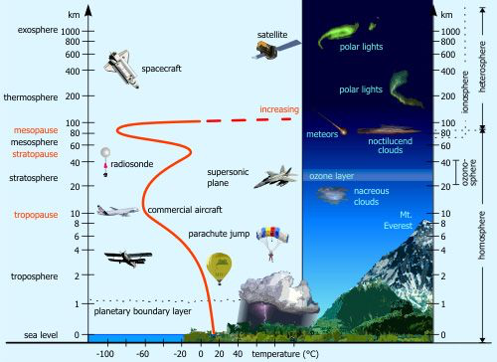
Physical Attributes of the Atmosphere

Slide 3
Troposphere (Tropos – means change in Greek)
  Turbulence, convective instabilities
  Clouds (Dew Point)
Tropopause – much less bumpy (why we fly there)
Stratosphere – much less mixing..
  Upper part of stratosphere is Chemosphere.
Mesosphere
Thermosphere (Ionosophere)

Slide 4
How does pressure vary with height?
Imagine a pilot needs to know how pressure varies with height in the lower atmosphere. How might you calculate this?
What assumptions might we make?
  Ideal Gas
  Constant Temperature (Really drops

Slide 5
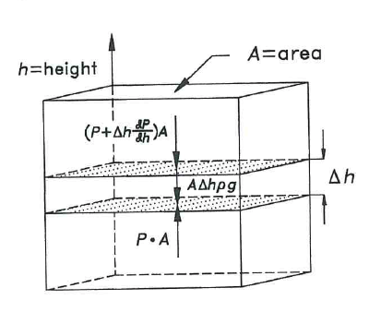
Balance

Slide 6
Balance

Slide 7
Balance

Slide 8
Sample Question
A pilot takes off from an airport at sea level and flies to an airport that is 1000ft above sea level.
(a) At 2000ft above sea level, what will the pressure read on the plane be. Assume standard temperature of 15ºC and atmospheric pressure of 1 atm.
(b) The altimeter is a pressure gauge that translates pressure into height. Imagine atmospheric pressure at sea level increased by 2%. If the pilot does not correct for this what height will she actually be at when it reads 2000tf.

Slide 9
Atmospheric Stability
When thinking about lakes we said that lakes are stable when they are uniform in temperature – or basically when warm water sits on top of cold water (roughly – you have to be careful with water around 4ºC).
Is the same true for the atmosphere?

Slide 10
Atmospheric Stability
Due to compressibility of air neutral stability occurs when the vertical temperature gradient that is measured (actual lapse rate) is equal to the adiabatic lapse rate.
Adiabatic lapse rate is the rate at which the temperature of an air parcel changes in response to the compression or expansion associated with elevation change, under the assumption of an adiabatic process

Slide 11
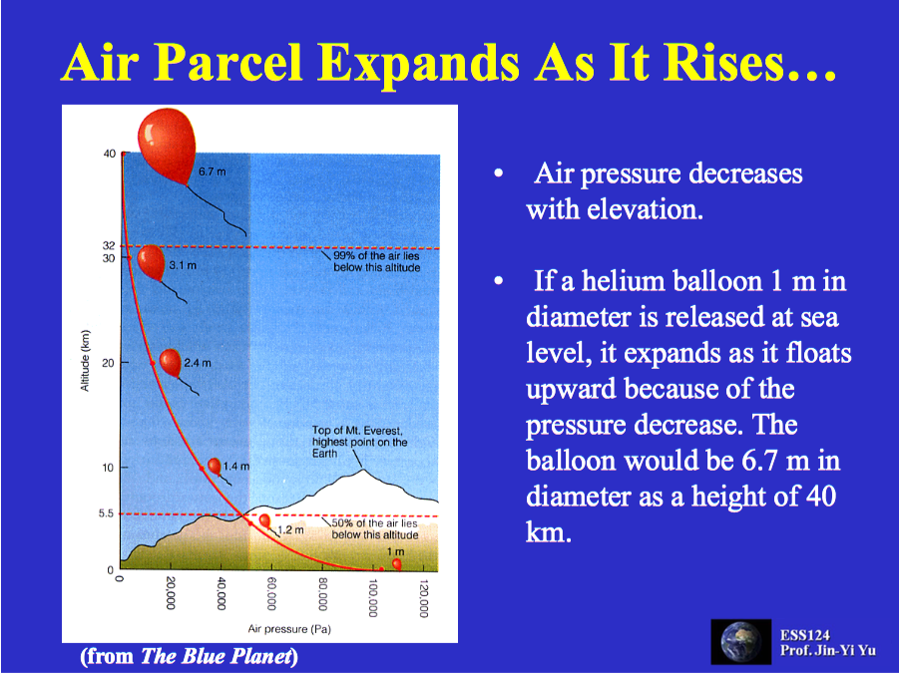

Slide 12
The Dry Adiabatic Lapse Rate
Consider a parcel or air that is free to expand, but does not exchange mass or energy with the surroundings (like an insulated baloon)
Conservation of Energy
  Mechanical Work performed by the air as it expands is equal to the decrease in the internal energy of the air

Slide 13
Recall from before for an ideal gas
K/m
K/km

Slide 14
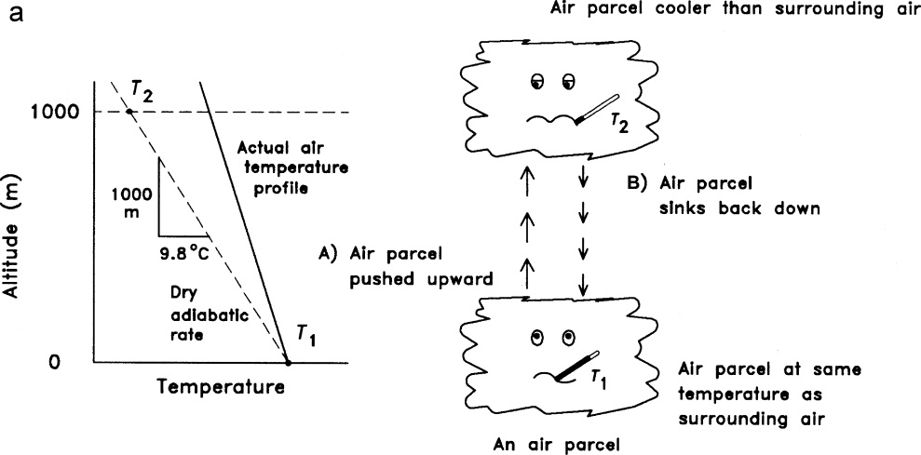
Stability and Lapse Rates

Slide 15
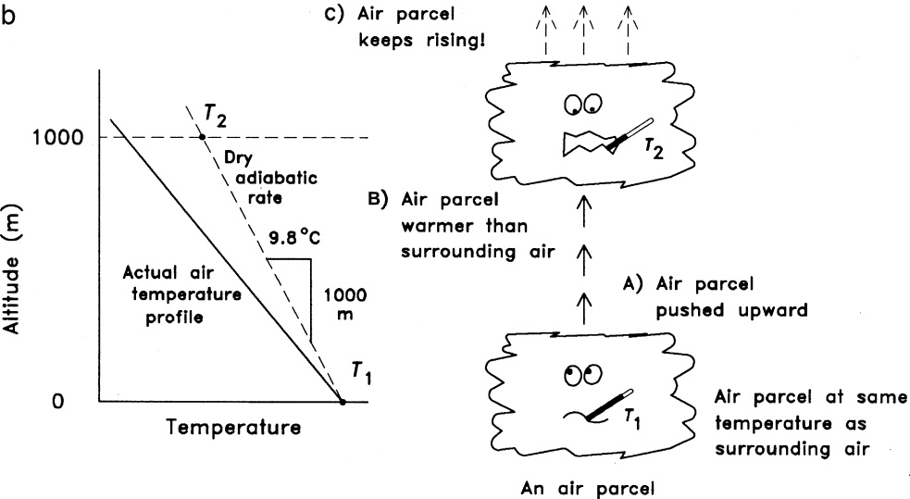
Stability and lapse rates

Slide 16
In the troposphere typically temp decreases at a rate of about 6.5 K/km
So is it stable?
Yet we know that there is a lot of mixing.
What is going on?
Local Conditions matter a lot – Moisture for one…
Wet abiabatic lapse rate (often quite a bit less than dry adiabatic lapse 3.6-5.5 K/km.)

Slide 18
What determines how a smoke stack blows?

Slide 19
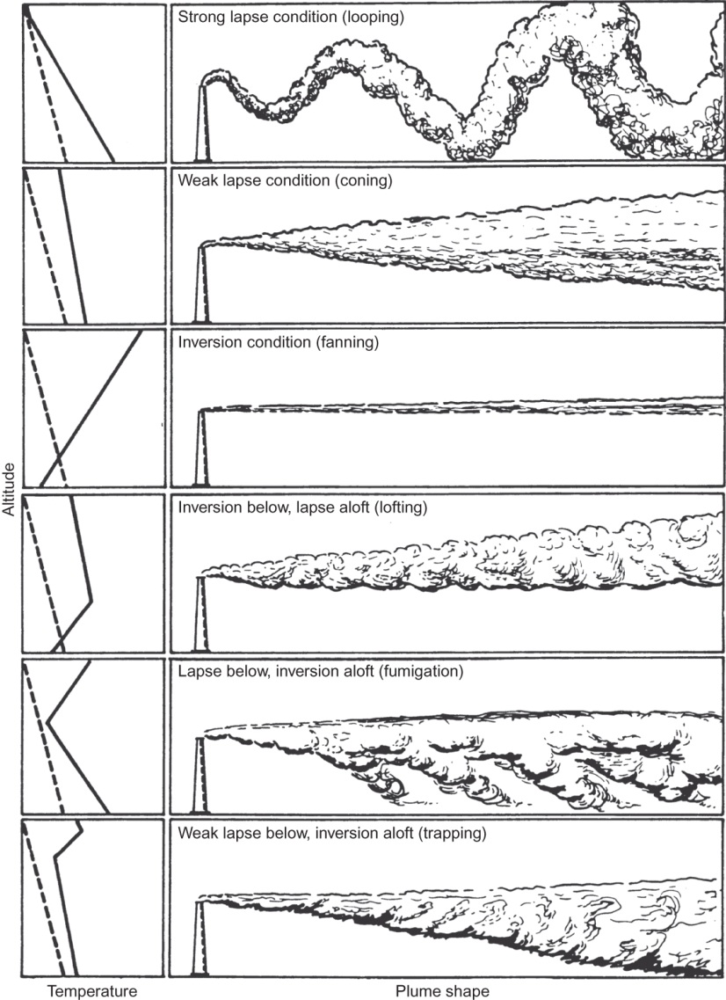
Emission of pollutants from a smokestack under a variety of meteorological conditions.
Dry adiabatic Lapse Rate is dashed line. Measured lapse rate is solid line
When measured>adiabatic unstable.

Slide 20
Pollution From a Point Source
Imagine a stack of height H_{s} and wind of speed u
u
How do I predict concentration downstream of the stack?
What do I have to account for?
H_{s}

Slide 21
Pollution From a Point Source
Vertical Dispersion
u
Vertical Dispersion σ_{z}
H_{s}
Will eventually feel ground
z
x=0
z=0
x

Slide 22
Pollution From a Point Source
Horizontal Dispersion – Overhead view
u
y
Horizontal Dispersion σ_{y}
y=0
x=0

Slide 23
Pollution From a Point Source
Buoyancy
u
ΔH
Vertical Dispersion σ_{z}
H_{s}
ΔH – the plume rise (a plume will rise because it is hotter than the surrounding air)

Slide 24
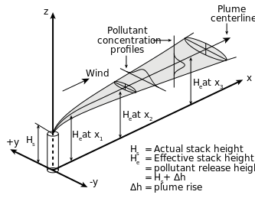
Gaussians

Slide 25
Gaussians
H(x) – effective stack heighg H_{s}+ΔH

Slide 26
Gaussians
Buoyancy Flux
T – Temperature
s – stack
a – ambient
d – diameter
V – stack gas velocity

Slide 27
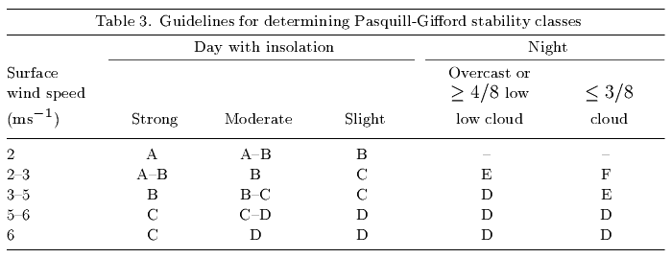
What about spreading σ_{y} and σ_{z}
Depends on Condition – Wind & Insolation

Slide 28
What about spreading σ_{y} and σ_{z}
Different Models
  Pasquill-Gifford

Slide 29
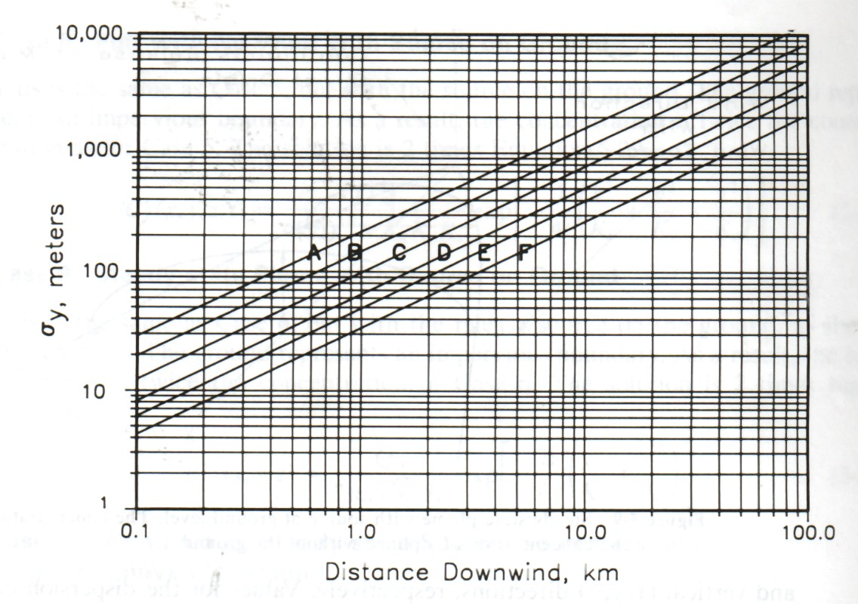
Pasquill-Gifford - Look it up…

Slide 30
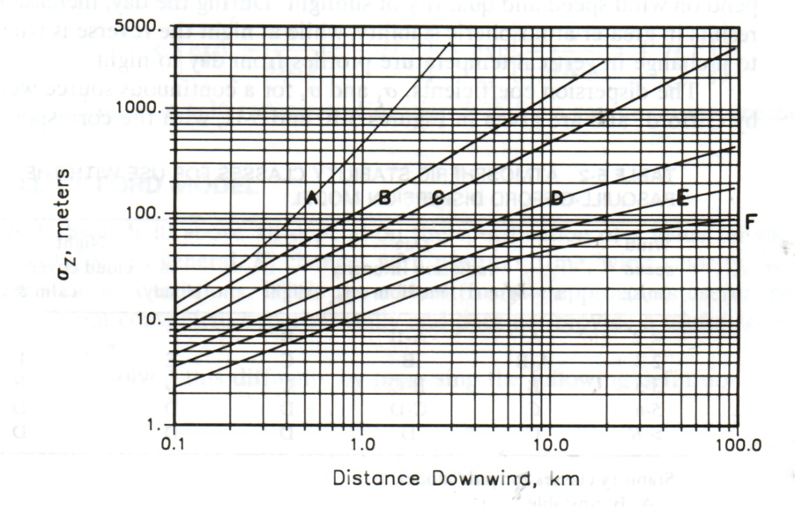
Pasquill-Gifford - Look it up…

Slide 31
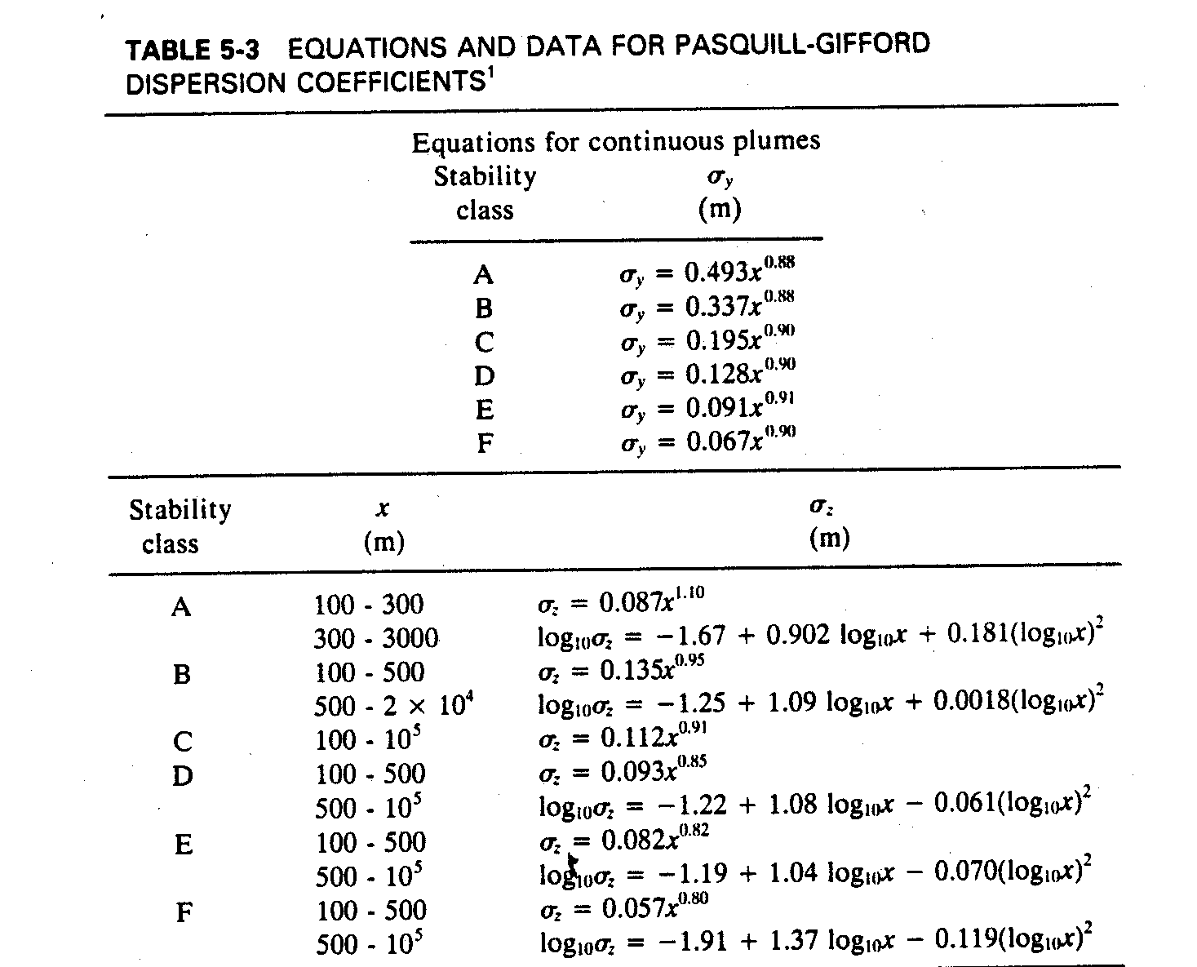
OR

Slide 32
OR Equations

Slide 33
OR Equations

Slide 34
Sample Problem
A chemical plant stack emits an estimated 3g/s of oxides of Nitrogen. The tower is 10 meters tall, emitting gas at a temperature of 60 degrees Celsius at a stack velocity of 0.1 m/s. The stack diameter is 1 m.
What is the ground level concentration from this source directly downwind at a distance of 3km on an overcast night with a wind speed of 7 m/s?

Slide 35
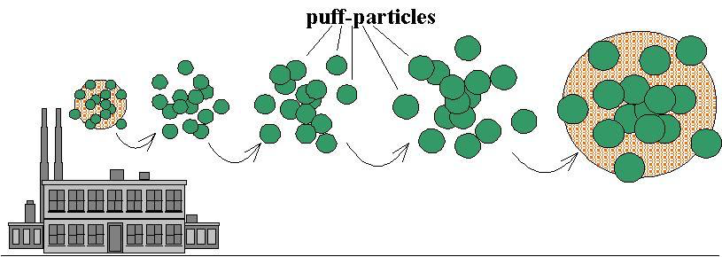
The Puff Model
A different model based on stability conditions of the atmosphere…
Instead of a continuous source there is a puff release
Exactly like pulses we considered in two other systems

Slide 36
Solution

Slide 37
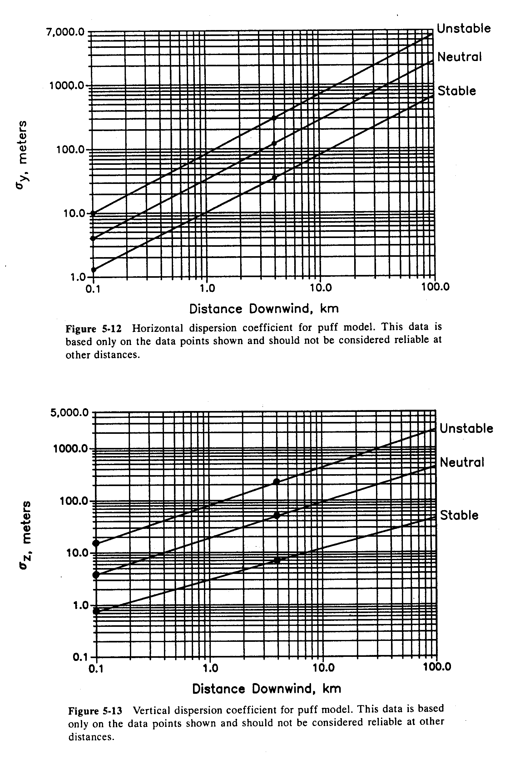
Puff Model Dispersion Coefficients

Slide 38
Sample Problem
A dump is burning garbage and a tank blows up releasing an estimated 10kg of Carbon monoxide in a single short puff. You may assume that the release happened 1 meter above ground level. Predict the ground level concentration after 650 seconds from this source directly downwind at a distance of 1km on a day with stable atmospheric conditions where the wind is blowing at 1.5m/s.

