Slide 1
Transport in Groundwater
The Basics
Contaminant Transport

Slide 2
In General
Recall the ADE in general is
If flow is incompressible
In GW we will consider transport in 2d in a uniform velocity field. Overhead view – because aquifers typically extend much further horizontally than they are deep.

Slide 3
In General
The ADE in 2 d is
Question – why do I only consider velocity in x direction and not also in y?

Slide 4
What is the advection velocity u?
Typically in groundwater systems we measure the Darcy velocity using Darcy’s law
Is velocity u just q_{x}?
No – Darcy velocity is not the speed at which water actually moves, but a volume averaged velocity, which does not distinguish between fluid and solid phase in porous medium

Slide 5
What is the advection velocity
Typically in groundwater systems we measure the Darcy velocity using Darcy’s law
This is the actual average
Pore water velocity
n_{e} – effective porosity

Slide 6
What about the Dispersion Term
As before dispersion causes ‘spreading’ of the solute plume
It is composed of two component
  molecular diffusion
  mechanical dispersion
  These can not be distinguished on the Darcy scale and so are lumped together

Slide 7
Diffusion
Diffusion describes the spread of particles through random motion from regions of higher concentration to regions of lower concentration.
Fick’s Law - diffusive flux
The diffusion coefficient depends on the materials, temperature, electrical fields, etc.
Typically not as large as mechanical dispersion (but this is context specific)

Slide 8
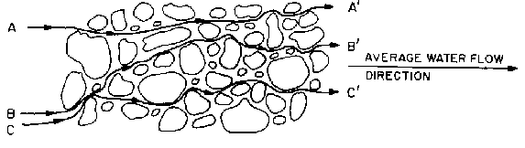
Mechanical Dispersion
Mechanical dispersion reflects the fact that not everything in the porous medium travels at the average water flow speed. Some paths are faster, some slower, some longer, some shorter. This results in a net spreading of the solute plume that looks very much like a diffusive behavior.
So are D_{x} and D_{y} (longitudinal and transverse) the same??

Slide 9
Think about it on a medium like this.
Draw some particle trajectories
And then ask
Which is bigger?
D_{mech,x} or D_{mech,y}

Slide 10
In Porous Media Mechanical Dispersion
Since mechanical dispersion depends on the flow, it can be shown that in the context of a a porous medium that it increase with increases flow speed. The exact relationship depends on many factor, but the most commonly applied model is the Scheidigger model, where The most common expression for mechanical dispersion is give by
α is called the dispersivity.
|u| is the absolute value of pore water velocity

Slide 11
In Porous Media Mechanical Dispersion
α, the dispersivity, is different in the longitudinal and transverse directions.
Typically
What do you think that the dispersivity depends on? Look at its dimension when thinking about this.

Slide 12
Retardation
When solutes flow through a porous medium they can interact with the solid phase. In particular they can sorb and desorb, which flows how quickly solutes moves relative the flowing water.
Recall conservation of mass
Split concentration into mobile and immobile concentrations
By definition j, the flux will only move C_{m}

Slide 13
Mobile -Immobile
We can write a conservation equation that looks like this
Assume that mass transfers between mobile and immobile states faster than any other time scale in our system -> i.e. mobile and immobile concentrations balance immediately (equilibrium).
Equilibrium coefficient

Slide 14
Mobile -Immobile
Combining everything we can write
Which we typically write as
Retardation coefficient

Slide 15
What does retardation do
Slows down time
Or perhaps more intuitively – reduces transport rates
Effective velocities and dispersions are reduced by a factor R

Slide 16
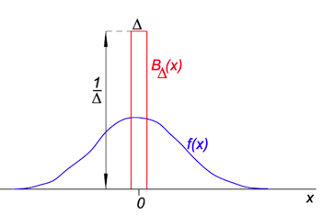
The Fundamental Solution
As before, in order to understand the role of each of these processes we will study how they affect a delta pulse initial condition
The delta function is like an infinitely thin
infinitely peaked pulse. It can be though of
as an approximation to a very narrow
exponential or Gaussian. An important property
is
This allows us to put in a desired mass

Slide 17
Recall in 1-d
So, if you had to guess, what do you think the solution to this is

Slide 18
Solution
Solution
Combine

Slide 19
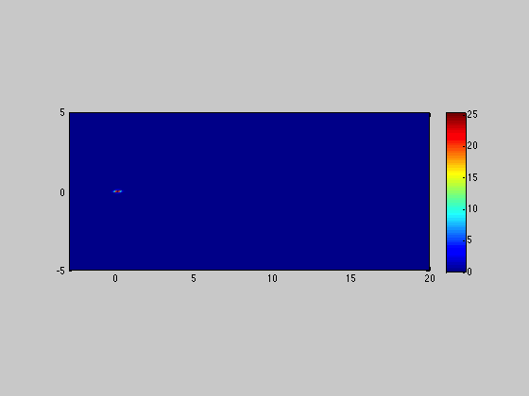
Movie

Slide 20
What does this concentration distribution look like?
So what does this look like?
Let’s consider five cases and plot them at time t=10;
R=1; u=1; α_{L}=0.1;x’=0;y’=0; D_{mol}=10⁻⁵;
R=2; u=1; α_{L}=0.1;x’=0;y’=0; D_{mol}=10⁻⁵;
R=1; u=1; α_{L}=1;x’=0;y’=0; D_{mol}=10⁻⁵;
R=1; u=10; α_{L}=0.1;x’=0;y’=0; D_{mol}=10⁻⁵;
R=1; u=10; α_{L}=1;x’=0;y’=0; D_{mol}=10⁻⁵;
Codes online

Slide 21
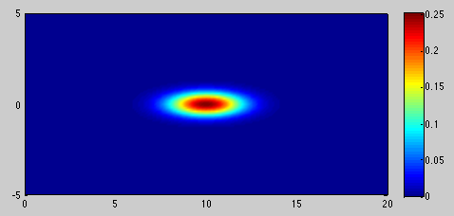
Case 1
R=1; u=1; α_{L}=0.1;x’=0;y’=0; D_{mol}=10⁻⁵;
What do you think the other cases will look like relative to this one?
R=2; u=1; α_{L}=0.1;x’=0;y’=0; D_{mol}=10⁻⁵;

Slide 22
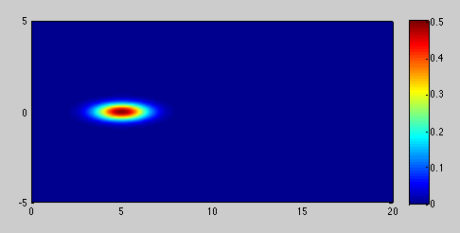
Case 2
(ii) R=2; u=1; α_{L}=0.1;x’=0;y’=0; D_{mol}=10⁻⁵;
(iii) R=1; u=1; α_{L}=1;x’=0;y’=0; D_{mol}=10⁻⁵;

Slide 23
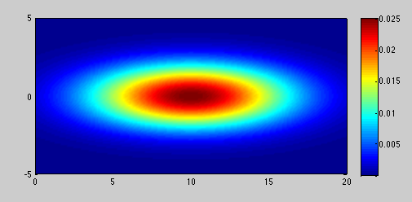
Case 3
(iii) R=1; u=1; α_{L}=1;x’=0;y’=0; D_{mol}=10⁻⁵;
(iv) R=1; u=10; α_{L}=.1;x’=0;y’=0; D_{mol}=10⁻⁵;

Slide 24
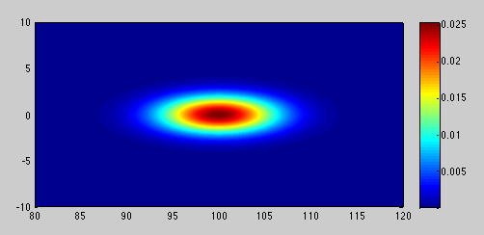
Case 4
(iv) R=1; u=10; α_{L}=.1;x’=0;y’=0; D_{mol}=10⁻⁵;
(v) R=1; u=10; α_{L}=1;x’=0;y’=0; D_{mol}=10⁻⁵;

Slide 25
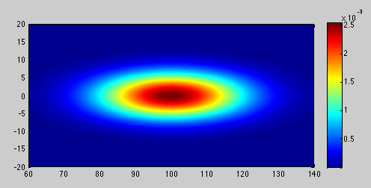
Case 5
(v) R=1; u=10; α_{L}=1;x’=0;y’=0; D_{mol}=10⁻⁵;

Slide 26
As before –
Relevant Questions
How would we quantify the maximum concentration and how it evolves in time?
How do we quantify the position of plume?
How would we quantify the extent of the plume?

Slide 27
As before –
Relevant Questions
How would we quantify the maximum concentration and how it evolves in time?
How do we quantify the position of plume?
How would we quantify the extent of the plume?

Slide 28
As before –
Relevant Questions
How would we quantify the maximum concentration and how it evolves in time?
How do we quantify the position of plume?
How would we quantify the extent of the plume?

Slide 29
As before –
Relevant Questions
How would we quantify the maximum concentration and how it evolves in time?
How do we quantify the position of plume?
How would we quantify the extent of the plume?

Slide 30
Different Mass Spill
Hopefully this
is obvious
to you
M is the mass of the spill

Slide 31
Sample Problem
A spill of a contaminant into an aquifer has occurred. The spill was short and over a small area. The total mass of the spill is 10kg. You know from a recent study that the Darcy velocity of this aquifer is more or less uniform in one direction and of magnitude 2m/day. The effective porosity of the aquifer 0.3.
200m downstream of the spill location is a well field. There are five wells along a line perpendicular to the direction of flow located at y=-20,-10,0,10,20 (where y=0 aligns with the center of mass of the plume).
The molecular diffusion is 1e-9 m^2/s. The longitudinal dispersivity is 0.01 m.
Calculate concentration arriving at these well and plot breakthrough curves.
If you recall in one dimension – the area under these curves was a constant – is that the case here?

Slide 32
Spatial Moments
Now moments consider x and y directions
Zeroth Moment m_{0,0}
First Moments m_{1,0} and m_{0,1}
Second Moment m_{2,0} and m_{0,2}
Second Centered Moment (κ₁₁=m_{2,0}-m²_{1,0} , κ₂₂=m_{0,2}-m²_{0,1} )
What about the cross moments?? m_{1,1} and m_{2,2}

Slide 33
Moments
Note I have set R=1
Why?
Zeroth Moment – 1 (normalized total mass)
First Moments – m_{1,0}=ut and m_{0,1}=0 (center of mass)
Second Moments – m_{2,0}=2D_{x}t+u²t² m_{0,2}=2D_{y}t
Second Centered Moments κ₁₁=2D_{x}t κ₂₂=2D_{x}t

Slide 34
Sample Question
You have the following graphs for the longitudinal and transverse second centered moments. Can you from these graphs infer the ratio of longitudinal to transverse dispersivities.

Slide 35
Question
We’ve been assuming that we can treat and aquifer as two dimensional.
When is it reasonable to do so?
You already know this from streams and rivers – so think about it.

Slide 36
Degradation
What if we include first order degradation? Again – let’s set R=1 for simplicity.
What do you think the answer will be? Use everything you learned before to justify your answer

Slide 37
Degradation
Again – just the conservative answer times exp(-γt)

Slide 38
What about a different boundary condition/setup?
on x=0 between y=-L/2 and y=L/2
Think about what this represents….
Answer is pretty huge – see next page…

Slide 39
Ridiculous Answer..
Can you tell if we
are neglecting anything
in this solution?
But what does it look like? – see Matlab script Steadystate.m

Slide 40
Baseline parameter
In the Matlab script Steadystate.m we start with parameters
  u=0.01;
  alpha_L=1;
  alpha_T=alpha_L/10;
  C0=1;
  L=1;
  gamma=0.1;
  t=10;
Plot this solution and then vary them to see influence

Slide 41
Steady State?
Consider steady state and a source
on x=0 between y=-L/2 and y=L/2
Doe this plume reach a steady state?

Slide 42
Steady State
Do you see what happened? – Any estimate for how long it might take to reach steady state?

Slide 43
Sample Problem
There is a continuous source of NAPL leaching toxins into an aquifer where the background flow is uniform with Darcy velocity 2m/day. The aquifer porosity is 0.25 and the longitudinal dispersivity is 0.01m.
The NAPL source aligns perpendicular to the flow and spans a width of 50 meters. Its concentration is 5g/liter.
In the absence of reaction how far down stream do you have to go along the plume centerline (where concentrations are highest) to get a concentration 10⁴ times smaller than the source concentration.
By adding bacteria you can induce first order chemical reaction and the rate can be controlled based on the type and amount of bacteria you put in. If you need the distance where the concentration is 10⁴ times smaller than the source concentration to be 10¹¹ times smaller than what you calculated before, what reaction rate do you need to impose.

